Slide 1
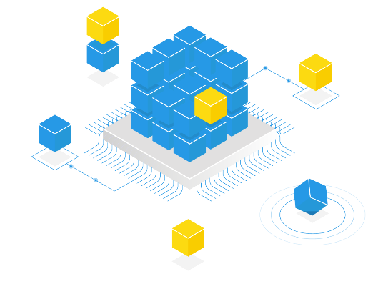


The Data Governance repository and Data Catalog
August 26, 2024

Slide 2
Meta Analysis slideshows
The discovery webinar
  Society, issues, functions, uses and demo
Analysis repository :
  The company
  The issues
  Functions​
  Uses
  The advantages
  Corporate
-> Throughout the document, return to the slideshow menu by clicking on the logo

Slide 3
The company, customers and partners
The company

Slide 4






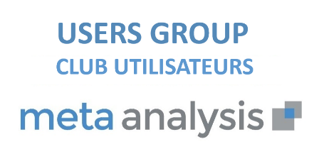

The company Meta Analysis
The company Meta Analysis
  Independent company of DATA publishers
  R&D, development and support in France (Bilingual English)
  20 years of experience and customer feedback
Our customers
  Customers in all areas
    Bank – Insurance – Mutual
    Retail – Industry – Service
  L
A Users Group bi-annual |  | UGAP referencing for public accounts

Slide 5



Our “Consulting” partners
A network of European and North American partners
  “Data Governance Consulting Firms” partners whose primary mission is to support clients on cross-functional organization and business value
  Partner consultants are trained and certified on the latest versions of Meta Analysis
A partner support consulting and training department
  Meta Analysis offers you expertise and training services
  This support complements that of your partner to ensure the success of your project

Slide 6
The evolution of the Meta Analysis repository
Analysis product
Strong customer involvement through workshops
2 annual versions and a 3-year roadmap
An international version
2002 – V 1
2024 – H1
Data Mesh
AI product governance
2019 – V 7.0
New architecture
2023 - V 7.2
New portal and
Scalable DataLineage
2024 – V 7.4
AI-assisted search

Slide 7
The challenges of data governance
Governance issues

Slide 8
The strategic issues of governance
The exploitation of DATA is at the heart of the priorities. Data governance has therefore become key for organizations!
For business and customer challenges : Take advantage of all your data to turn it into a competitive advantage
For regulatory issues and constraints including the GDPR and now the EU AI Act
To control your data and respond to the challenge of autonomy of Data Domains and Data Mesh
Governance
Improve the relationship through quality
Customers
Ensure regulations
EU IA Act
Legal
Ensuring federated governance
Internal

Slide 9
The answer to business questions
I have to successfully merge two companies with different cultures and languages.
The General Director
How do we calculate the margin(s) in the company?
Who validates the management rule?
The Financial Director
Where does my data come from?
Is it transformed?
The management controller
I want to understand my Order Management process
The Logistics Director
I want to know the quality level of my customer base for a marketing operation
The Marketing Director
I would like to know where customer personal data is in the Information System
The DPO
Meta Analysis will help answer the following governance questions, which are at the heart of the concerns of management and functional teams

Slide 10
Questions from the DATA and IT teams
I want to explain and share the DATA approach with business management and the CODIR
The CDO
I want to give autonomy to Data Domains with the Data Mesh project
The Data Governance Manager
I need to have a complete and simple vision of my business area
The Data Steward
I need to know what the quality level of data is to prepare my predictive analyzes
The Data Scientist
I want to know the business definition of information to design my reporting
The Data Analyst
I want a complete map of my IS with my on-premises and cloud databases
The IT Director
Meta Analysis will assist the DATA and IT teams with the following governance issues. Meta Analysis is also used to manage the creation phases of new DATA projects

Slide 11

The role of the CDO or Data Governance Manager
The Chief Data Officer and the Data Governance Manager are the guarantors of information and data quality for business users.
They need to have a complete vision and be able to share it with the entire organization.
Project management
Functional departments
Project management
IT
Information
job
Description of the Information System

Slide 12
Our beliefs
Data Governance, the prerequisite for the Data project!
  We now have DATA Governance projects prior to DATA projects and this allows:
    To ensure the involvement of the professions in the definition of information and indicators
    To develop the DATA environment with an unrivaled level of precision and quality
    To follow the construction phases of the DATA project and DATA visualization
  Contributions: Coherence, Collaborative, Simplicity, Visibility
We recommend implementing Meta Analysis before your DATA innovation project and to use it as collaborative support for your future DATA development

Slide 13
Meta Analysis functions
The functions

Slide 14
The functions and their challenges
Organization of governance
Business Glossary - Business information
IS mapping –
Data catalog
Applications -
Application information
Data Quality (option)
GDPR
(option)
Scalable Data Lineage – Impact Analysis

Slide 15

Organize data governance
The organization
The first challenge of data governance is to organize around it.
What organization should be put in place?
What are the roles and responsibilities of each actor?
How to manage the transversality of this project?
It is necessary to clearly define the phases of the Governance project with policies and standards, business processes and roles, strongly involving business departments.

Slide 16
Organizing with Meta Analysis
The roles
allow us to allocate uses
Domains
ensure information
Business processes
allow you to describe business operations
The owners
supervise elements of the repository
The governance project
with policies and standards

Slide 17

Business information or Business Glossary
Business Glossary
The second challenge of data governance is to have a single business information repository
What is my company information?
What do they mean?
What are the management rules?
Who is responsible for developments (Data owner)?
The margin is not unique: “Gross” and “Net” margins have different management rules
This Business Glossary becomes the memory of your company.
It must be shared simply and known to everyone.

Slide 18
Understand your job with the Business Glossary
The portal
with the personalized dashboard
Business topics
to organize information
Unique information
multilingual
A workflow
functional validation
Management rules
unified

Slide 19

Business applications and application information
Applications
The 3rd challenge of data governance is the application part.
What are my business applications?
What information is available in these applications?
To what business information is the application information attached?
A single business information (Business Glossary) may have several variations of application information
Data quality will therefore be linked to application information

Slide 20
Understand its applications
Application mapping allows you to:
  Identify existing applications in the organization (ERP, BI, CRM, etc.)
  Associate application information with each application
  Associate unique business information from the Business Glossary with “n” application information
Business Glossary | Unique business information
Applications | nx Applications
 | nx Application information
e-mail
ERP
BI
ERP – user email
BI - email address

Slide 21

The challenges of Data Quality
Data Quality
The 4th challenge of data governance is to monitor the quality of information.
What is the quality of this application information?
How does this quality evolve?
How to visualize it simply for professions?
It is necessary to define quality thresholds, define which controls to carry out and monitor them cyclically by campaign.
Departments, for example Marketing for an email or SMS campaign to its customers, can see whether the information is reliable and of quality.

Slide 22
Data quality
Definition of controls
with quality thresholds by professions
Graphical visualization of quality
On the information
Storing results
quality campaigns
Return of results
Data Quality campaigns

Slide 23
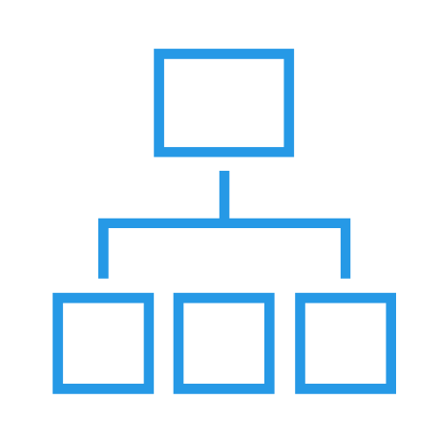
IS mapping or Data Catalog
  IS mapping
The 5th challenge of data governance is the mapping or Data Catalog part
What are the storage, transformations, data flows and restitutions that make up my information system?
In the event of a problem encountered (GDPR type) or a request for functional development, it is necessary to be able to identify the location of the data, the transformations applied in the flows and the uses in the reporting and analysis solutions.
All this mapping information from the Information System allows us to have an overall picture

Slide 24
Understanding your Information System
Repository
Meta Analysis
Production bases
Data Integration (ETL)
Reporting and analysis
Servers
Data Warehouse
All your business software has descriptive metadata allowing the construction of the repository, including Cloud and SaaS solutions
Through robotic connectivity, Meta Analysis will make it possible to centralize and share all of the metadata of the elements making up your information system in complete independence from database, flow and reporting solutions.
Meta Analysis will give you a global vision of your business assets.

Slide 25
The stages of cartography or Data Catalog
Identify IS sources
to map
Map
automatically
To plan
the loads
View associations
components
of the IS

Slide 26
Associations Information – Applications – IS
Business Glossary
Information System Mapping
Applications

Slide 27
Uses of Meta Analysis
Uses

Slide 28
Simple and advanced uses
To research
Collaborate
Analyze
Share
Access
For simple users
The portal and searches
For contributors and explorers
The graphic design and sharing workshop
Scalable Data Lineage

Slide 29
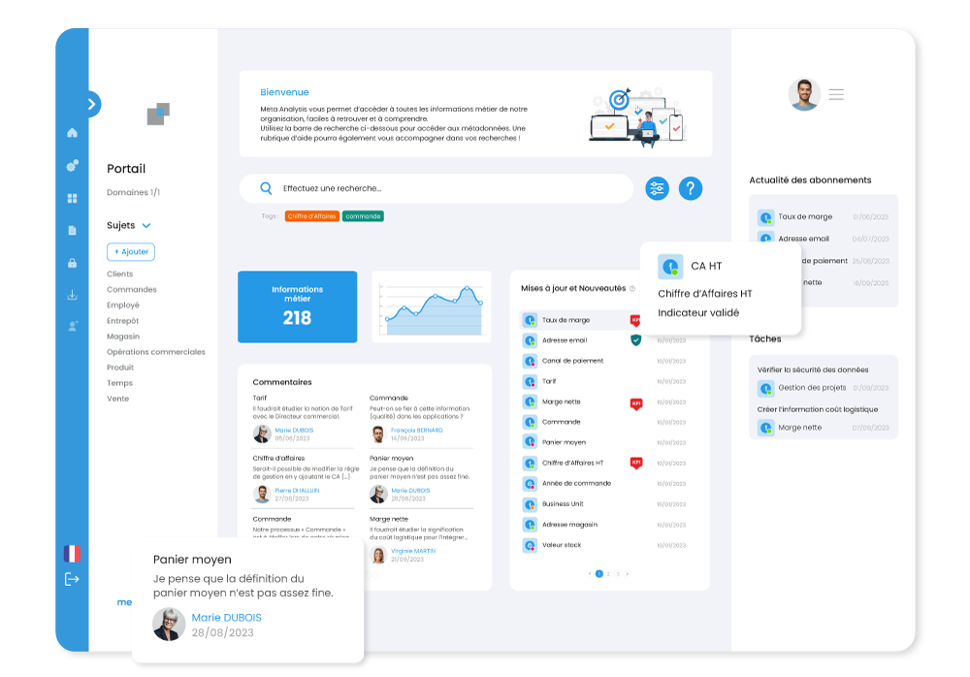
The portal as simple access
  Access
The portal is the simple entry point to Meta Analysis for all users including simple readers
It provides all the information allowing you to follow your areas of interest
  At the center, simple search with AI, tags, new information or updates and comments
  The left menu with authorized domains, business subjects and their information
  The personal right menu with subscriptions, tasks to be carried out and exports

Slide 30
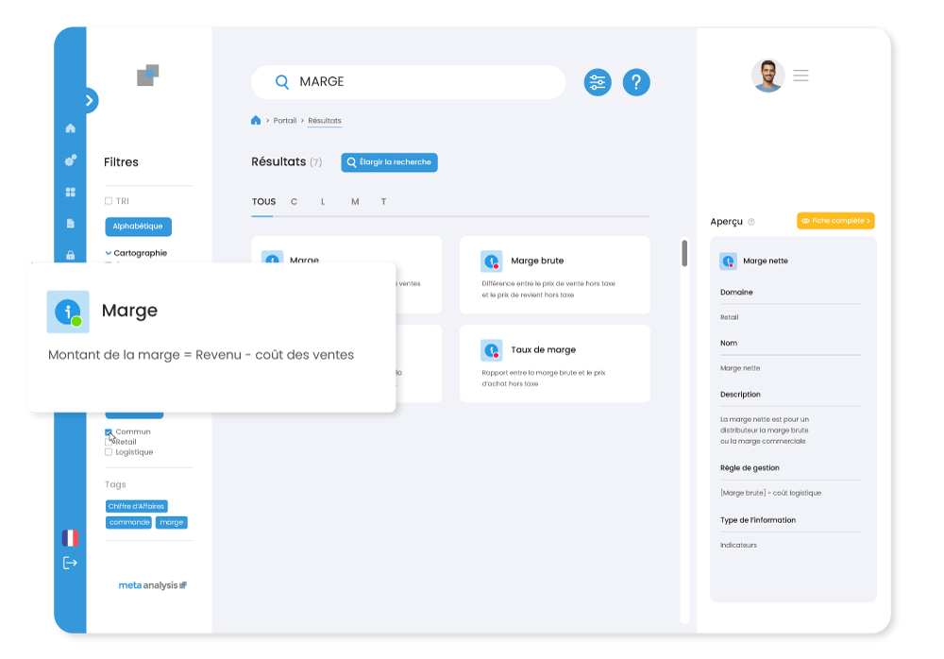


Searches and filters on results
  To research
Simple search is the essential function of users
  The result will be in 3 parts with the exact results, suggestions and more research into the variables
  Advanced filters allow you to select the metadata you are looking for
The AI module for user experience
  Version 7.4 brings AI into the search module and enables semantic search
  Synonym management complements the AI module to provide global search

Slide 31
Search capability and AI
Simple search
On all items with advanced filters
Advanced search
Multi-criteria with filters
Tags
On all elements of the repository
AI research
Semantic search and synonyms

Slide 32
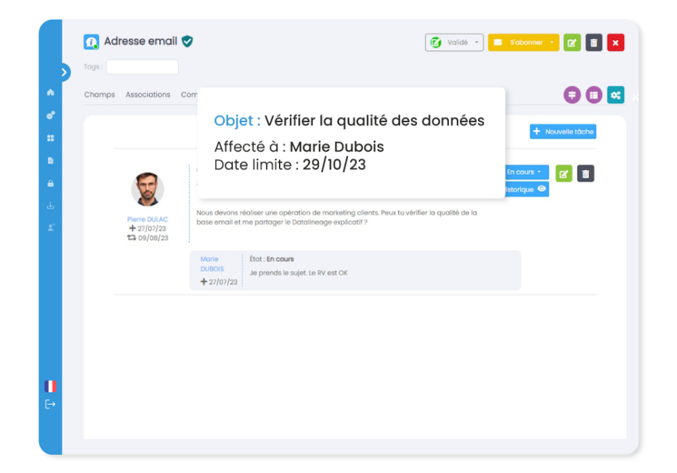
Enrich with collaborative functions
  Collaborate
Comments
Tasks
Comments help enrich discussions
Tasks allow you to assign actions to be carried out with their monitoring

Slide 33
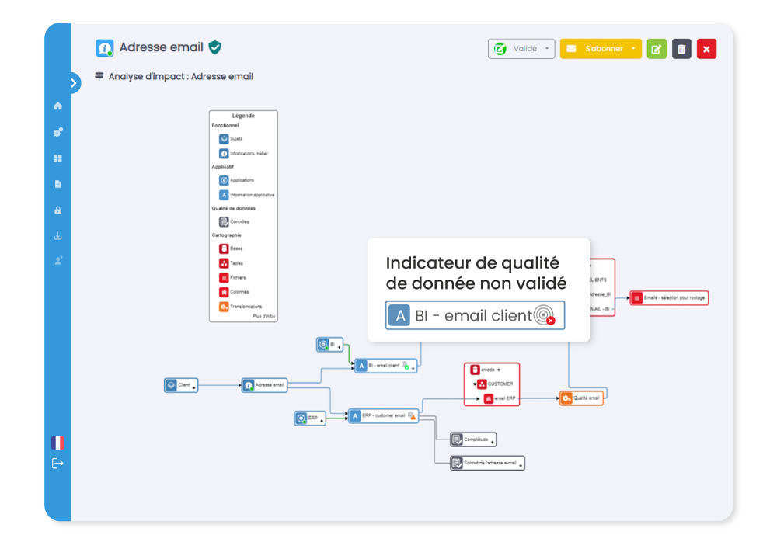
Create and analyze with scalable Data Lineage
  Analyze
Meta Analysis allows you to have a complete Data Lineage on the repository: Processes - Information - Applications - Information system to enable impact analysis
Where does this data come from?
What are the transformation(s)?
Is quality controlled?
Who is responsible?
So many questions that can be resolved by retracing his life, from the source to the target through the transformations.
Meta Analysis allows you to enrich the repository in graphical mode by adding metadata and associations directly to the Data Lineage

Slide 34
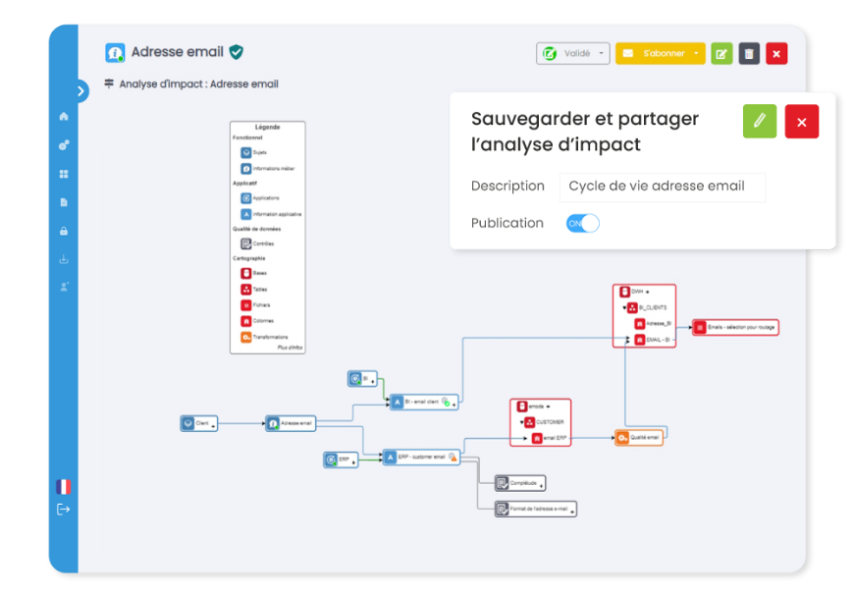
Save and share Data Lineage
  Share
The new Data lineage brings a powerful collaborative function
  It is possible to save your impact analysis for reuse.
  It is possible to share the Data lineage with other authorized users.
A marketing specialist will therefore be able to share the life cycle of information in the organization with business departments.

Slide 35
Scalable Data Lineage
Create
To safeguard
Analyze
Share
Data Lineage: The graphic design and sharing workshop
Create or import metadata
Create associations
Analyze using icons, Data Quality and the power of “Data Lineage”
Save your “Data Lineage” for reuse
Share “Data Lineage” with users

Slide 36
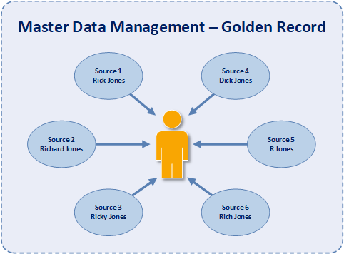
Golden records or reference data
  Identify
The process of defining reference data (MDM or Master Data Management) is an important point of Data Governance
The technical part of MDM is handled by specialized tools
The goal in Meta Analysis is twofold
  Include the location of the reference data
  Highlight associations linked to reference data

Slide 37

The demonstration
Demonstration

Slide 38
Elements of Meta Analysis
Scalable Data Lineage
 | Organizational layer
GDPR | Functional layer
 | Application layer
 | Mapping layer
Organization and Business Processes
Business information/Business Glossary
Applications/Application information
Data quality
IS mapping
Searches and scalable data lineage can be carried out on the entire repository

Slide 39




The actors
Demonstration in collaborative mode
Married
Data Steward
Marketing domain
Rock
Data Steward
Logistics field
John
CDO
English subsidiary
Thomas
DG Manager
Mesh

Slide 40
Demonstration in SaaS mode
Demonstration
In SaaS mode in Azure

Slide 41
The strengths and differentiators of Meta Analysis
The advantages

Slide 42

Functional richness
Meta Analysis is 20 years old
  Based on the experience of our first clients including banks and insurance companies, Meta Analysis is functionally rich
Simple to get started
  We provide predefined roles, basic workflows, generic metamodel, project monitoring
  Datalineage allows for quick handling
Complete to deploy
  You can add metadata and associations and reconfigure the metamodel to adapt to your growth

Slide 43

Full customization without development
We provide you with a basic metamodel
  It can be completed or simplified from the start of the project.
  It is fully configurable
You have a specific organization
  It is possible to simply add metadata as well as the associations between them
  It is possible to add them during the project to take into account the maturity of the participants

Slide 44

Historicizing developments
How it works
  All changes in metadata are recorded
  Originally a legal constraint, this makes it possible to find changes to the information and the entire repository
The future
  Ability to find a situation on a given date

Slide 45

Native multilingualism
Is your business international?
  If the answer is positive, it is possible to start very simply in bilingual French – English
  We provide the language(s) you wish to implement, with no limit on the type of languages or number
  You can associate people of different languages in the same projects

Slide 46
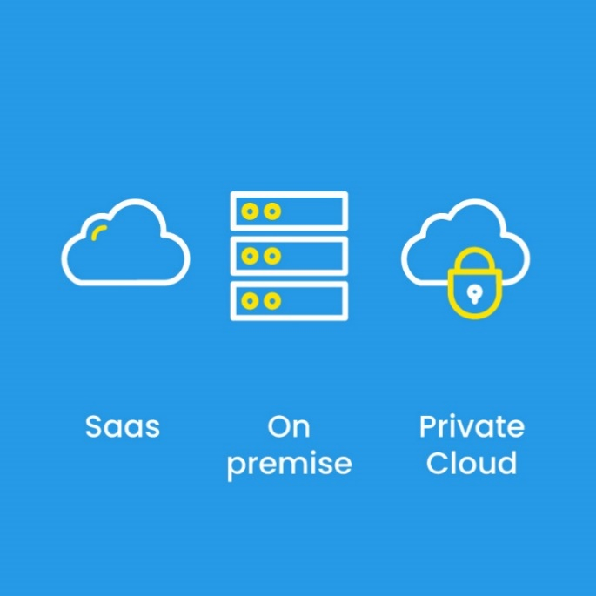
Installation: your choice
You are a supporter of the cloud
  We set up Meta Analysis for you in a dedicated cloud environment in Azure in the desired country
  We administer the platform and we upgrade the version after your agreement
You are a supporter of “On premise” or private cloud
  We assist you in implementing Meta Analysis in your environment
  We can assist you with version upgrades
You can simply change your environment

Slide 47

Open solution
The loading principle
  Never re-enter metadata:
  Native loading via connectivity or CSV
  Loading planning and robotization
The principle of access
  Native by searches and integrated reporting
  Direct based on the repository (open and shared schema)
  Integration of information into business reporting (Power BI, Tableau, etc.)

Slide 48
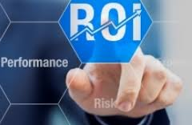
Fast ROI
Subscription cost/performance ratio
  Subscription of €3K per month in SaaS mode
  30 users including 10 contributors
  3 connections
Fast ROI
  Calculation of ROI based on contributions
  First results in 3 months (scope to be defined)

Slide 49
Integration into corporate reporting
Reporting integration

Slide 50








Objective
Meta Analysis centralizes all definitions within your company
Meta Analysis allows you to share your definitions directly in your business documents.
Connectivity
Reading the repository

Slide 51



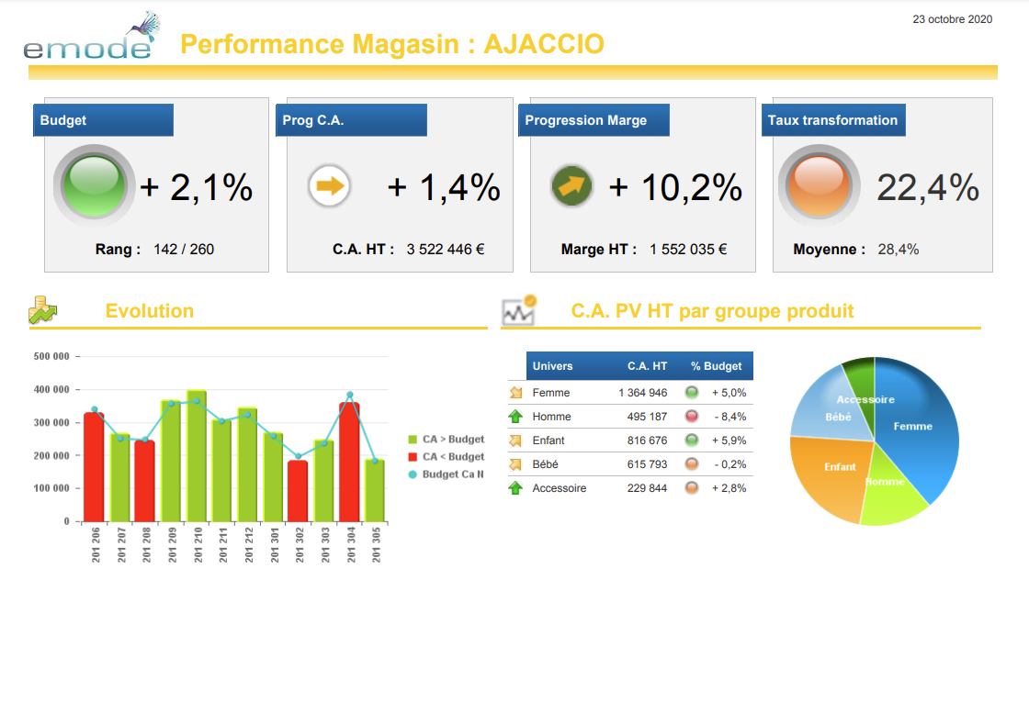
Creation in your Datavisualization
In your data visualization tool, you will have to create a data source on the Meta Analysis repository
In each document referencing business definitions, add the data source by filtering the document to have the indicators
View
DataSource

Slide 52

Conclusion
www.meta-analysis.fr
Events, blog and documentary space

